Slide 1
Double Your Business in
90 Days
WITH CHANTEL RAY AND TSHANE JOHNSON

Slide 3
This is sales, guys
People are not going to go out of their way to call you your agenda and your business is not important to them.
This isn't Match.com. All right. This isn't dating. This isn’t.
You have to reach out to your prospects. Don’t wait for them to reach out.

Slide 4
This is sales, guys
Make it a point to call a minimum of 50 people per day. Work your way up to 80 per day.
Consistency + Action = Success

Slide 5
Get a funnel to create leads with no risk & low risk offers.​
Spend most of your money on digital advertising​
Follow up on lead in 5 minutes or less​

Slide 6
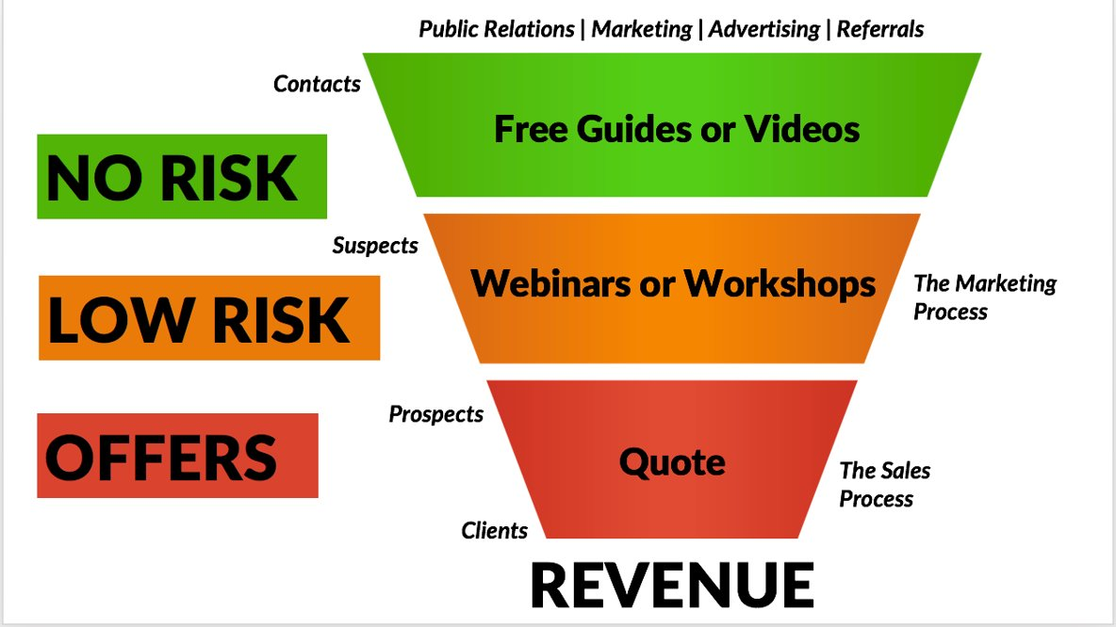
Spend most of your money on digital advertising

Slide 7
The statistics don’t lie
1.93 billion daily Facebook users
85% watch videos without sound
Square videos get 35% more views
86% of internet users with $100k+ income use Facebook

Slide 8
Get engagement
Post A/B/C to get people to comment
Took some new pictures this week for a card I am doing
Which one do you like A, B, or C?

Slide 9
Get engagement
Or just A/B… but make it fun
Help me decide which you like the best on these ? There is actually 2 I really don’t like but my friend loves so we will see which you guys chose !
We have a little wager going on this ! Curious 🧐 which one of us will 🥇 win 🧐

Slide 10
Get engagement
Message 50 people on Instagram and Facebook
Message 50 people something new Monday through Friday.
Private messages. Copy and paste. Easy peasy. No more than thirty minutes.
Just wanted to send you a quick message, did you get a chance to watch the Super Bowl? I was rooting for the Bengals. Sad that they lost. Wanted to see if you saw my latest video on 10 reasons why we have no inventory right now. Will you watch it and tell me what you think?

Slide 11
No Risk, Low Risk, Offers
“Why Didn’t Our Home Sell?” Guide
“7 Tips to Staging Your Home” Guide
“5 Steps to Buying Your New Home” guide
AUTOMATED CMA
No Risk
Low Risk
CMA (Takes Name, Email, Address) Market update
Offers
List your home with us!

Slide 12
Newsworthy Headlines
Can’t Sell Your Home? I Can Fix That!
Get Rid Of Low Ball Offers For Good!
How To Create The Perfect Listing!
The 10 Commandments Of Buying A Home!
How To Sell In A Slow Market!
Looking To Invest? Here’s How!​

Slide 13
Focus on Niche
Don’t spread yourself thin by serving everyone. Focus on a niche and specialize in it.

Slide 14
Focus on Niche
Category
Specialty
Niche

Slide 15
Focus on Niche
Plastic
Surgery
Specializes in Boob Jobs
Surgeon

Slide 16
Focus on Niche
Residential
Condos
Real Estate

Slide 17
Focus on Niche
Mastery
Shiny Object
Once you start to master something, there’s a tendency for it to become a little boring or at the very least, routine. It is extremely important to fight this temptation.
Many entrepreneurs are tempted by the dreaded “shiny object syndrome.”

Slide 18
Focus on Niche
The Hedgehog Concept
Jim Collins, who studied how companies went from mediocre to excellent in his book Good to Great, found that great companies specialized in what he called "The Hedgehog Concept” which was coined from Isaiah Berlin’s essay “The Hedgehog and the Fox.” As Collins explains it, “The fox knows many things, but the hedgehog knows one big thing… Foxes pursue many ends at the same time and see the world in all its complexity… Hedgehogs, on the other hand, simplify a complex world into a single organizing idea, a basic principle or concept that unifies and guides everything.”

Slide 19
Focus on Niche
The Hedgehog Concept
Collins believes great companies only focus on market segments that meet three criteria:
1. What your people are truly passionate about
2. What the organization does better than anyone else
3. Where it’s good at generating revenue

Slide 20
Stay in your lane from what makes you different.
You need to stand out from the competition. Stay in your lane.

Slide 21
Stay in your Lane
Things you can offer
When I was purchasing my house, I tried to get in contact with 3 agents.
2 never responded.
1 reached out to me… AFTER 2 WEEKS.
So, I thought, there has got to be a better way!!

Slide 22
Stay in your Lane
Things you can offer
I asked people what they hated the most about some real estate companies and everything the told me, I decided to provide.

Slide 23
Stay in your Lane
Things you can offer
Issue: They were stuck in a contract.
Our Solution: We have a “Fire Me Guarantee"

Slide 24
Stay in your Lane
Things you can offer
Issue: They could never get in contact with an agent.
Our Solution: We have an agent on duty from 8am-9pm each day of the week. We never miss a call!

Slide 25
Stay in your Lane
Things you can offer
Issue: You buy a house you thought you loved…now you see something you hate, but you’re stuck.
Our Solution: Love it or Leave it Guarantee. If you don’t love the house the first 3 months, we will list it for free!

Slide 26
Stay in your Lane
Things you can offer
Issue: Not enough marketing to sell their home.
Our Solution: We pay THOUSANDS for marketing. It doesn't fall into the lap of the agents. Your home will be on 56+ sites!

Slide 27
Create a trackable call to action
People make all these POSTS and there is no call TO ACTION

Slide 28
Trackable CTA
Go To: Budweiser.com/SUPERBOWL
Once you visit their website you get the 10 tips to throwing a super bowl party.

Slide 29
Speed & follow up leads
How fast does your sales and marketing team move when a new lead comes in?
At many companies, the average lead response time is nearly 47 hours.

Slide 30
Speed & follow up leads
That timeframe may have worked in the past, but online consumers have little patience for waiting.
If you want to convert leads into sales, timing is everything.
Speedy responses are the key to converting email leads to customers.

Slide 31
Speed & follow up leads
Every minute counts
According a Velocify Survey- lead conversions are 391 percent higher if you call within a minute of an online inquiry. Waiting an additional minute drops that to 120 percent, and if you wait an hour, it drops to a low 36 percent.
Our clients often wonder, "How fast is too fast?" Let's put it in perspective.

Slide 32
Speed & follow up leads
Every minute counts
A consumer may be online completing a form one minute, and five minutes later, he or she may be watching a movie, shopping, or sharing family photos on Facebook.
People have short attention spans when they're online, so waiting even a few minutes makes a difference whether you make contact or not.

Slide 33
Speed & follow up leads
Phone or email?
Not all forms of follow up are equally effective for B2B leads.
Stop listening to people who tell you telephone prospecting is dead. It's all about who you call and when you call them.
Statistics show that following up by email is only half as effective as following up by phone. Surprisingly, follow up with email first followed by a phone call is even less effective.

Slide 34
Speed & follow up leads
Phone or email?
When it comes to your B2B prospects, always follow up an inbound lead with a phone call first.

Slide 35
Speed & follow up leads
Persistence Pays off
You shouldn't overwhelm prospects, but you don't give up after the first few tries, either.
If you don't make contact, try again at 30 minutes, an hour or two later, and then three more times every few days.
Remember to leave a voicemail from the very first attempt.

Slide 36
Speed & follow up leads
Persistence Pays off
The Velocify survey reveals that leads reached after seven or more calls are 45 percent less likely to convert.
That doesn't mean we stop trying, but we do need to work smarter and be more efficient.
When attempts on a lead approach double digits, it's best to turn the lead over to a remarketing campaign.

Slide 37
Speed & follow up leads
Persistence Pays off
Continue sharing value added resources, and the most interested prospects will eventually re-engage.

Slide 38
Speed & follow up leads
Call the lead right away. OK. Not what most realtors do. Wow. Busy right now. I'll call that one in a few hours and then you go to call them in a few hours. Let me look up the public record of the property that we're interested in so that I know everything I can about the property. Let me also print up the listing sheet and study the entire listing sheet and know everything about the property that the buyer is calling on. Because it's important that I know, know guys, that's a load of crap. It's not important. It's not important for you to know a lot about the home they're calling on. What's important is that you call them immediately.

Slide 39
Saying no to great ideas
The Time Vampires...Blood Suckers...Takers...and OPPORTUNISTS!

Slide 40
Saying no to great ideas
3. I've got this awesome opportunity I want to talk to you about, lets pop on a quick call.”
Pro Tip For Time Vampires: A halfway smart person can smell that minor league approach a mile away and will run. Second, you didn’t make a good impression.
Here’s a question: When is the last time you did something for that person before asking for something? Build a relationship, give something first before asking. The world will open up.

Slide 41
Saying no to great ideas
9 out of 10 times you never hear from them again
Their offer or pitch ain’t no good if they can’t distill it down to 3 sentences or bullet points.

Slide 42
Mastermind with smarter people
As Richard Branson put it, “It’s all about finding and hiring people smarter than you.”

Slide 43
Mastermind with smarter people
Indeed, it’s very easy to put networking on the backburner, but you should make a point to prioritize it as a part of your routine.
Not only have we found critical banks, lenders, contractors, vendors, and sellers through networking, but we have gotten a lot of great ideas from discussing real estate with other seasoned professionals.
And as you grow bigger you will want to bring some of those people into your organization and share responsibilities with them. Which leads to the next key step.

Slide 44
Delegate everything, but sex.
Unless you're tired... lol

Slide 45
Delegate everything, but sex
Somebody recently asked me, “what do you mean by time management and delegation?"
My answer is this: Time management is refusing to waste too much time on low-value, low-enjoyment activities.

Slide 46
Delegate everything, but sex
There are two parts to it:
Identify what you should, or want to be doing
Make time to do it (and do it).

Slide 47
Delegate everything, but sex
You need to decide how you want to invest your time.
You need to maximize the time you spend on high value work and things you enjoy in life.
You also need strive to block, reduce, or eliminate the tedious and negative crap that will fill up your time (and your soul) if you don’t do something on purpose to prevent it.

Slide 48
Delegate everything, but sex
I shouldn’t get too caught up reacting to the work that came in, but that I should keep my mind and my plate clear to understand what even-more-important stuff I should be doing…
And by “delegating almost everything,” I was giving myself a chance to do the highest-level items at the highest level

Slide 49
Delegate everything, but sex
No one ever wishes for more low-value, tedious, busy-work.
Most people agree they would be better at their job if they had more time to think.
The common fear of delegating is that it will take longer (it does in the moment), or that it will not come out right (it sometimes won’t).

Slide 50
Delegate everything, but sex
Exercise #1
A wonderful thought exercise to figure out what you should be doing is this:
Imagine that you delegate 100 percent of the work you are doing right now. Yes, 100 percent. So you get to work the next day and you have absolutely nothing on your task list.
Then what would you do? What new, higher-level, value added stuff would you do? What are the top 5 things you love to do?

Slide 51
Delegate everything, but sex
Exercise #2
If you don’t know, and you can’t see what else you should be doing at your level, there are two groups of people you should talk to.
Individuals: First have one-on-one meetings with the individuals in your organization. Ask them what is working and not working. I promise you will get an earful of issues and ideas that “if only management would work on” things would be better. This is how I always figured out what to do when starting a new job.

Slide 52
Delegate everything, but sex
Exercise #2
2. Sit and watch what people are doing and see how to make it more efficient.
You also need strive to block, reduce, or eliminate the tedious and negative crap that will fill up your time (and your soul) if you don’t do something on purpose to prevent it.

Slide 53
Focus on lead measure, not lag measure

Slide 54
Lead not Lag Measure
Client Satisfaction
Employee Satisfaction
Revenue
Profitability

Slide 55
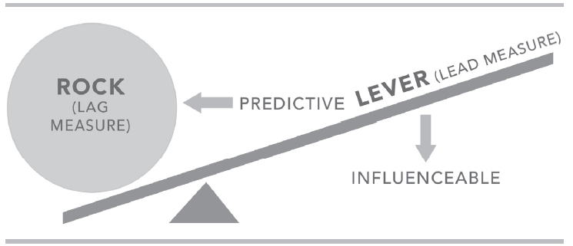
Act on Lead Measures
Lag Measurement
Measures The Goal or a Result
Lead Measurement
Measures something that leads to a goal

Slide 56
Lead not Lag Measure
20% of what we gets us 80% of the results we want.
There are a few things that are drivers ; we get a huge return;
Finding leverage:

Slide 57
Making phone calls
Sending notes
Following up
Getting appointments
Hiring more agents
Notes:
Let’s try to think of some possible lead measures in recruiting.. Remember a Lead measure are the “measures” of the activities most connected to achieving the goal. And lets assume our goal in this example is to increase our hires from 1000 to 1100.

Slide 58
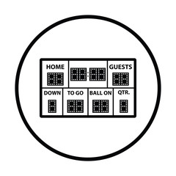
People play differently when we keep score
We will be creating a PLAYERS score board
Our scoreboard will be visually evident if we are winning or losing
Show Visual Lead & Lag measures!
Simple and FUN (game-like)

Slide 59
Create Policies to avoid decision fatigue

Slide 60
Create Policies to avoid decision fatigue
We’ve also created a policy manual and rules for everything. This process will take time, but it’s something you should think about right away.
There’s something called "decision fatigue". Basically, every decision you make takes energy. You want to put these decisions, especially the day-in and day-out decisions that are made repeatedly, on autopilot.

Slide 61
Create Policies to avoid decision fatigue
Save your energy for the bigger decisions.
Having these policies in place also makes it much easier to delegate tasks to others since you know they will follow a pre-set plan and not do something in a way that you would not accept.

Slide 62
Cadence of Accountability

Slide 63
Cadence of Accountability
We will meet for 20 minutes each week
Can NOT talk about anything related to the Whirlwind during meeting.

Slide 64
Cadence of Accountability
Each person will:
Account: Report on last weeks commitments
Review Scoreboard: Learn from success and failures
Plan: Commit to 1 or 2 things. Clear the path and make commitments.

Slide 65
Focus on the Wildly Important Goals
Act on the Lead Measures
Keep a Compelling Score Board
Keep a Cadence of Accountability
Notes:
So,

Slide 66
Outsource everything that
are not core competencies
"Delivering Happiness” the Zappos story by CEO Tony Hsieh. One thing jumped out at me in his book and it’s the title of this post. “Never outsource your core competency.”
Example: Agents.
Showing time is an example of good outsourcing.

Slide 67
The following 5 ALIVE formula can be used to guarantee success each week. 1. Call 200 ( Expireds, FSBO, or Older leads) 2. Facebook Frenzy ( 4 posts a week ) 3. Elbow Rubbing ( 3 times a week) (this needs to have 2 conversations about real estate each time in order for it to count) Rubbing Elbows (any event where you actively each out to people about real estate): • Networking event • Speed networking • Bible study • Garage sales • Kids soccer games 4. Power Hour - reaching out to your personal sphere asking for referrals or contacting old leads that have reached out to you previously (2 times a week ) 5. Monster Open House (1 time a week)

Slide 68
Pillar
-
Open
houses
do work

Slide 69
open houses do work
There are 4 steps to ensure your Mega Open House is successful. Do NOT miss any steps.
Think of it like Baking Brownies, you need to put all the ingredients together in the exact way instructed,
If you skip a step, your brownies do not turn out right. The same is true with your Open House!
“There are NO shortcuts to success…The only shortcut is doing it right the first time!”

Slide 70
open houses do work
STEP 1 – PLANNING
1. Property “AKA Your Storefront” is where your “Ideal Client” is buying or selling.
2. Property is within ½ mile from a “New Build Development” (Preferred)
3. Property is within ½ mile from a Grocery Store.
4. Property is within ½ mile from one busy intersection with good drive by traffic.
5. Aerial street map viewed and number of signs identified

Slide 71
open houses do work
STEP 2 – MARKETING
1. Gift card purchased / ordered for raffle.
2. Prepare postcard mailing. Fliers ordered / printed.
3. Sign in forms in binder, pens, raffle tickets and a bowl / container.
4. Video created advertising the property.
5. Video uploaded to YouTube / Facebook.
6. Facebook Ad $25 (targeted or boost) to zip code advertising video for Open House. Set up for Weds, Thurs, Fri.
7. Facebook ad $10 (custom audience to your database. Set up for Weds, Thurs, Fri.
8. Items 4-7 suggested in addition to Broker Funded Marketing

Slide 72
open houses do work
STEP 3 – SET UP
1. All signs strategically placed where cars can see from all directions.
2. Pick up snacks / refreshments.
3. Arrive early, turn on all lights, open blinds, make sure entrances, patios, etc. are all swept and look great. You are on a “Job Interview” and you will be judged based on how the home is presented. Review the Client Full REIN Report and KNOW the property.
4. Table set up within 4 feet from the front door, with all marketing materials, sign in sheets and sign requesting them to sign in. Suggested marketing items include a financing flier from a mortgage vendor, small give-a-ways, a REIN Summary Photo Report plus One-Line Reports of other properties in the area and Business Cards!
5. Sign placed on the front door requesting everyone to sign in per seller..
6. Flags staked into the ground in front yard. (If using)
7. Quick 20 second selfie video completed and uploaded to YouTube / Facebook

Slide 73
open houses do work
STEP 4 – FOLLOW UP
1. Thank you video texted to every attendee that signed in with a cell/or if doing raffle video created and sent announcing the winner (If possible, do this at the property before leaving).
2. Close up property and collect all materials, signs and flags.
3. Go to office (right after event), enter all leads into your database and categorize correctly.
4. Set up lead on automated “Custom Home Property Alerts”
5. Set up lead on drip system.
6. Email lead informing them of the custom home search and thanking them again for stopping by.
7. 24 hour phone call follow-up.
8. Continued General Follow-Up.

Slide 74
Where did all the homes go?
Go to joincanzell.com/samples to get sample content to use for yourself.

Slide 75
Achieve your goals regardless of obstacles

Slide 76
Achieve Your Goals
1. Know exactly what you’re after in life.
What do you want your life to be like? When you’re sure, you can then plan your activities over the short and long term to help you achieve your goals.

Slide 77
Achieve Your Goals
2. Keep your list of life goals short and to the point.
What do you want your life to be like? When you’re sure, you can then plan your activities over the short and long term to help you achieve your goals.

Slide 78
Achieve Your Goals
3. Infuse elements of achieving your goals into your everyday life.
Let’s say one of your goals, a trip out of the country, will be to Australia 3 years from now. Have a couple of books about Australia laying around the house, on your coffee table and nightstand. Listen to music from Australia on your MP3. Watch television shows about Aussie land.
Have reminders and tasks to do that are related to meeting your life goals throughout your home. Make your life goals part of your everyday life so that even when times get bumpy, you’ll be able to keep your eyes on what’s really important to you.

Slide 79
Achieve Your Goals
4. Talk positively to yourself.
It can be quite helpful to use positive self-talk. When you do, you’ll be more likely to keep working toward your goals in life. Say something like, “I’m in a rough patch but I will still keep saving for my retirement and my kids’ educations.”
Other examples of positive self-talk are “I can get through this challenging phase just like I did before,” “As long as I keep moving forward, things will be okay,” and “Life has in store many more wonderful adventures for me.”
Using positive self-talk will keep your spirits buoyed when you feel like you’re floundering in choppy waters.

Slide 80
Achieve Your Goals
5. Reflect on your efforts in order to reinforce them.
Even though you may be struggling, think about what you accomplished just this week to achieve your goals. Maybe you made a couple of phone calls, explored the internet to gather information, or drew up a new budget to ensure you’re on target for saving for your life goals.
The fact is you did something. And recognizing that will reinforce your efforts in your quest to achieve your goals. You can excel in times of great challenge.

Slide 81
7 Common Obstacles & How to Navigate Them

Slide 82
Common Obstacles
1. Lack of creativity.
You might have your own struggles determining how to best work toward
attaining what you want. Perhaps you’ve run out of ideas to make it happen.

Slide 83
Common Obstacles
2. Negative thinking.
We’ve all been plagued by negative thinking. You feel you’re just not going to be able to achieve your dreams. Negative thinking is a potent block, because once it begins, it tends to escalate and can become a self-fulfilling prophecy.

Slide 84
Common Obstacles
3. Lagging confidence.
Following closely on the heels of negative thinking, sagging confidence is the bane of goal achievement. You begin to seriously question your skills and abilities to complete the work required to reach your goal.

Slide 85
Common Obstacles
4. Focus follies.
Who among us can claim we’ve never lost our way on the path toward our dream life? We want to reach that milestone but we keep getting thwarted by distractions. How can you work on an important project when your wife keeps asking you why you aren’t painting the house or spending time with the kids?

Slide 86
Common Obstacles
5. Refusing to put in effort.
It goes without saying that every goal requires you to work and persevere to reach success.

Slide 87
Common Obstacles
6. Time traps.
Making your way toward goals is challenging enough without having the irritation of not enough time to do it.

Slide 88
Common Obstacles
7. Vague aspirations.
If you’re unsure about what you really want, it’s a challenge to continue steadily toward your goals. Vague aspirations equal unmet goals.

Slide 89
Navigating Obstacles
1. Take responsibility to keep
creativity going.
Draw pictures of what you hope to achieve. Make a storyboard of your plan of action. Design a vision board of what your goal pathway looks like and include how your life will differ after achieving your goal.

Slide 90
Navigating Obstacles
2. Arrest negative thoughts.
As soon as they creep in, think, “Stop it now” and mean it. Then, replace that negativity with an “I will persevere and achieve” message. Tell yourself, “I can do it.”

Slide 91
Navigating Obstacles
3. Review past achievements.
Give yourself props for goals you’ve achieved before. What were those goals? Use these reminder techniques to find and connect with your confidence.

Slide 92
Navigating Obstacles
4. Commit to goals.
Remind yourself daily about why you want to reach a particular goal. Perhaps you’ll earn more money, get a better job, live in a place you prefer, or protect your family’s future. Stay the course by re-committing to goals each morning.

Slide 93
Navigating Obstacles
5. Work.
Along with committing wholeheartedly to goals, you’ve got to put in the work. Tell yourself your effort will, in the end, be worth it.

Slide 94
Navigating Obstacles
6. Use your schedule. No matter what your goal, consistently schedule the time to work toward it.
If you don’t keep a calendar now, start. Look at your entire week or month and what’s scheduled with a quick glance. Write in when you’ll work toward goals.
Maybe it will be Tuesday evenings from 7:30 p.m. to 9:00 p.m. or Saturday mornings from 8:30 a.m. to 10:30 a.m. Follow your schedule consistently.

Slide 95
Navigating Obstacles
7. Clarify goals.
Write them and place copies everywhere inside your house, briefcase, and calendar. When you’re sure about what you want, then you can diligently work toward those goals.

