Slide 1


Investor Presentation

Slide 2

Legal Disclosure
Certain statements herein relating to CanZell Realty Inc. (“CanZell” or the “Company”) constitute “forward-looking statements”, within the meaning of applicable securities laws, including without limitation, statements regarding future estimates, business plans and/or objectives, sales programs, forecasts and projections, assumptions, expectations, and/or beliefs of future performance. Such “forward-looking statements” involve known and unknown risks and uncertainties that could cause actual and future events to differ materially from those anticipated in such statements. Forward looking statements include, but are not limited to, statements with respect to commercial operations, anticipated revenues, the overall projected size of the market and other information that is based on forecasts of future results and other key management assumptions. The Company assumes no responsibility to update or revise forward-looking information to reflect new events or circumstances unless required by law.
Future Oriented Financial Information: To the extent any forward-looking information in this Presentation constitutes “future-oriented financial information” or “financial outlooks” within the meaning of applicable Canadian securities laws, such information is being provided to demonstrate anticipated results and the reader is cautioned that this information may not be appropriate for any other purpose and the reader should not place undue reliance on such future-oriented financial information and financial outlooks. Future-oriented financial information and financial outlooks, as with forward-looking information generally, are, without limitation, based on the assumptions and subject to the risks set out above. Our actual financial position and results of operations may differ materially from management’s current expectations and, as a result, our revenue and profitability may differ materially from the revenue and profitability profiles provided in this Presentation. Such information is presented for illustrative purposes only and may not be an indication of our actual financial position or results of operations.
This presentation constitutes an “offering memorandum” under applicable securities laws. Please refer to Appendix “A” hereto for important information regarding the statutory rights of action available to purchasers of the offered securities.
Appendix A
This presentation may be considered an offering memorandum (the “Offering Memorandum”) thereby granting the potential purchasers statutory rights and contractual rights of action. Securities legislation in certain of the provinces and territories of Canada provides purchasers or requires purchasers to be provided with a remedy for rescission or damages where an offering memorandum and any amendment to it contain a Misrepresentation. As used herein, “Misrepresentation” means: (a) in the case of all jurisdictions except Quebec, an untrue statement of a material fact, or an omission to state a material fact that is required to be stated, or that is necessary to make a statement not misleading in light of the circumstances in which it was made; and (b) in the case of Quebec, any misleading information on a material fact as well as any omission of a material fact. These remedies, or notice with respect thereto, must be exercised, or delivered, as the case may be, by the purchaser within the time limit prescribed by the applicable securities legislation. Each purchaser should refer to provisions of the applicable securities legislation for the particulars of these rights or consult with a legal advisor.
Rights for Purchasers in Ontario and British Columbia. In the event that this Offering Memorandum, together with any amendments hereto used in connection herewith, delivered to a purchaser of securities of the Company resident in Ontario or British Columbia contains a Misrepresentation, the purchaser will, as provided below, have a right of action against the Company for damages, or while still the owner of the securities purchased by that purchaser, for rescission, in which case, if the purchaser elects to exercise the right of rescission, the purchaser will have no right of action for damages against the Company, provided that: (a) the right of action for rescission or damages must be exercisable by the purchaser not later than, (i) in the case of an action for rescission, 180 days after the date of the transaction that gave rise to the cause of action; or (ii) in the case of any action, other than an action for rescission, the earlier of, (A) 180 days after the plaintiff first had knowledge of the facts giving rise to the cause of action or (B) three years after the date of the transaction that gave rise to the cause of action; (b) the Company will not be liable if it proves that the purchaser purchased the securities with knowledge of the Misrepresentation; (c) in the case of an action for damages, the Company will not be liable for all or any portion of the damages that it proves does not represent the depreciation in value of the securities as a result of the Misrepresentation relied upon; and (d) in no case will the amount recoverable in any action exceed the price at which the securities were sold to the purchaser. The foregoing summaries are subject to any express provisions of the securities legislation of each offering jurisdiction and the regulation, rules and policy statements thereunder and reference is made thereto for the complete text of such provisions. The rights of action described herein are in addition to and without derogation from any other right or remedy that the purchaser may have at law.

Slide 3
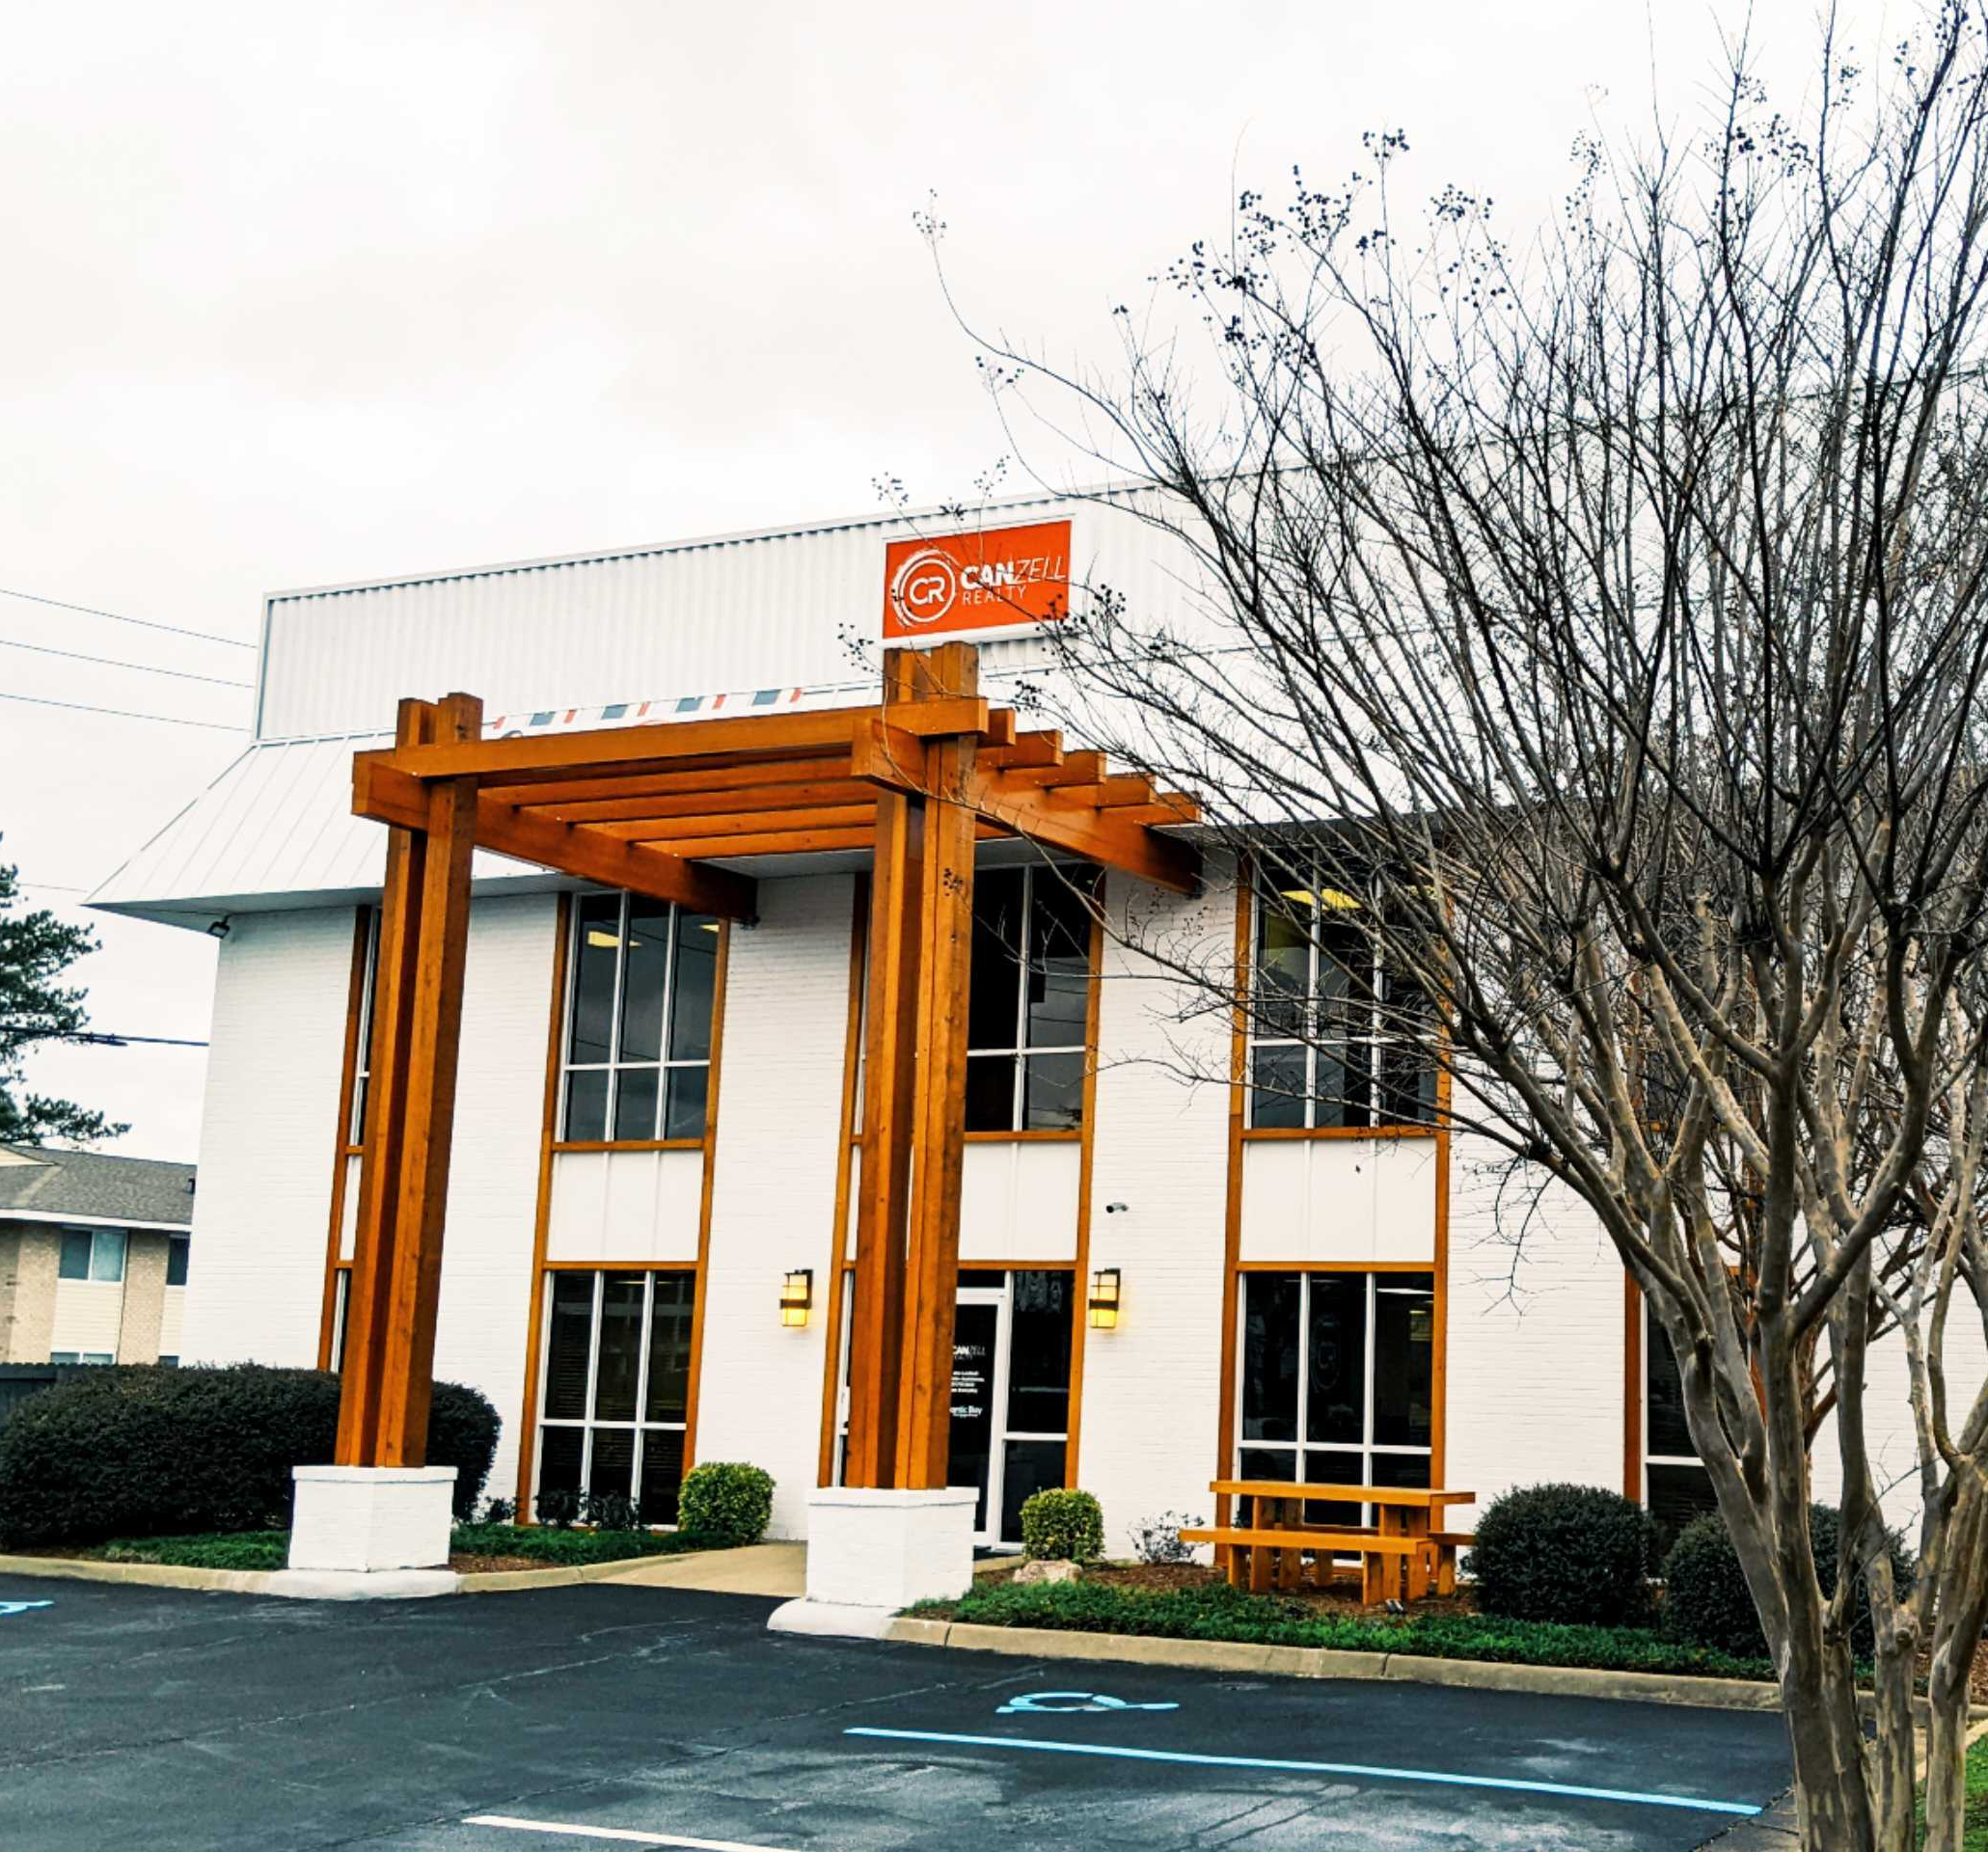
CanZell Realty is a national, hybrid-model real estate brokerage that continues to grow across the country everyday. We are currently in
18 states and counting!
Our corporate headquarters is located in Virginia Beach, VA
and most of our agents work from home, the beach, coffee shops – or wherever they want! All CanZell agents have access
to shared workspace lounges across the country.

Slide 4
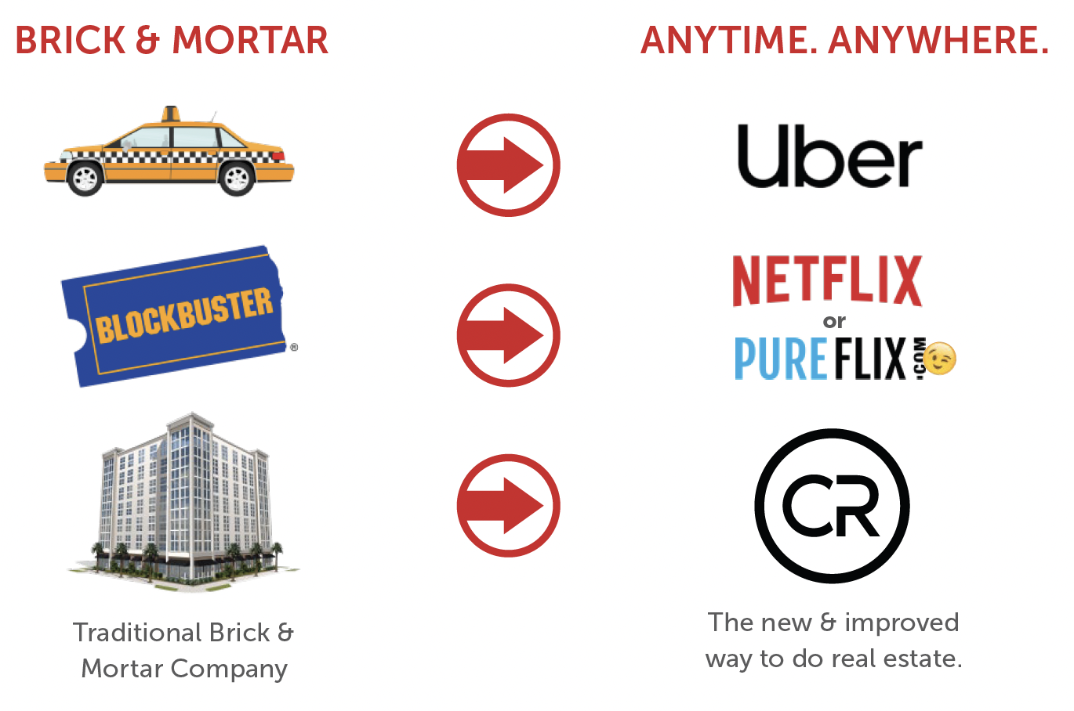
We like to explain our vision with similar examples from other industries.
Uber took over taxicabs, Netflix took over Blockbuster and we want to take over traditional brokerage models.

Slide 5


Disrupting the Real Estate Brokerage Model
VS.
High fixed costs (offices, personnel, and infrastructure)
Low agent income due to higher splits
to broker; 30% split average
Agent may invest less in marketing due to lower income
Difficult to attract and retain talented agents
Slow and expensive expansion due to need for brick and mortar
Software-based model operates in
the cloud
Scalable, asset-light with substantial lower overhead
Higher agent income
Agents can invest more money in growing business
Easier to attract and retain high performing agents
Faster geographical expansion thanks
to lower market entry cost

Slide 6
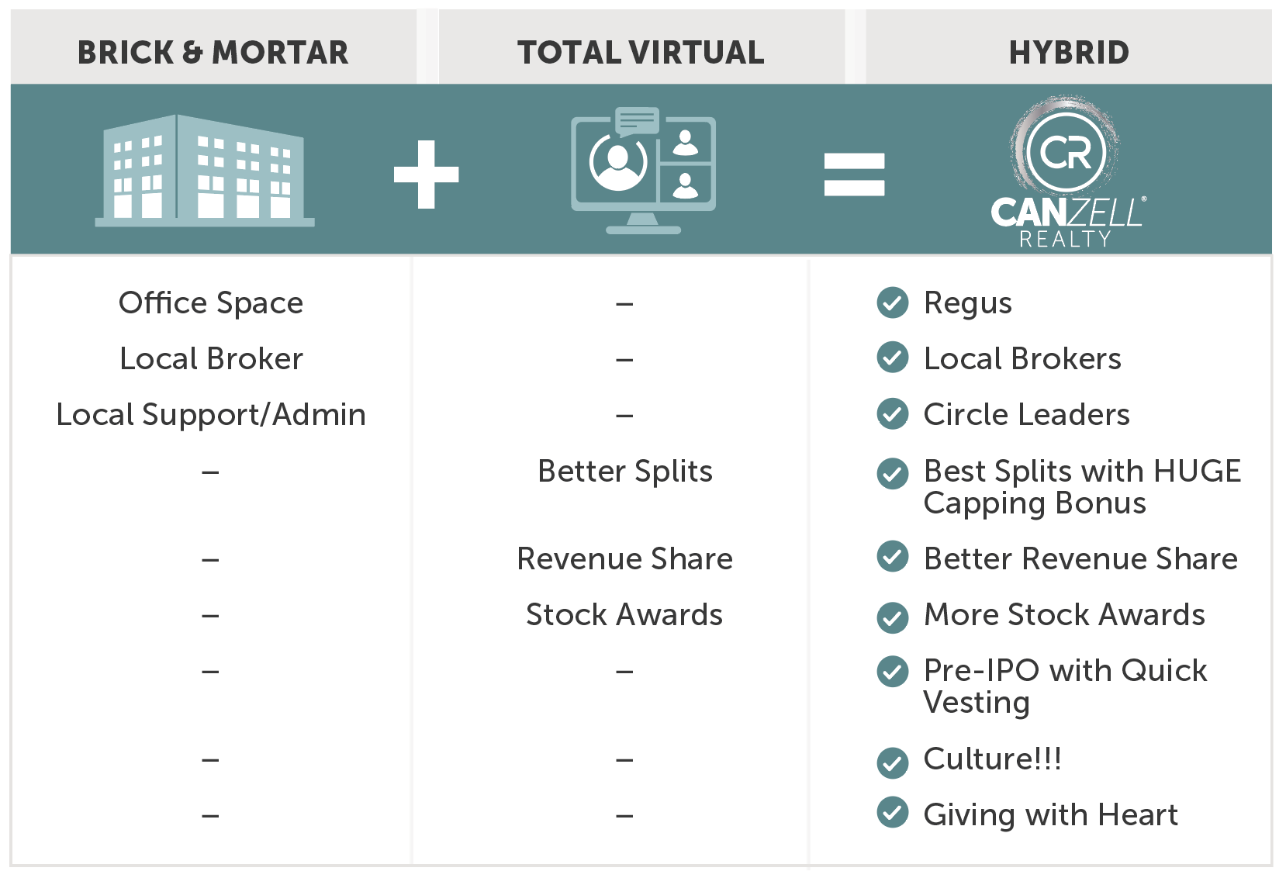
What does a hybrid-model look like?

Slide 7
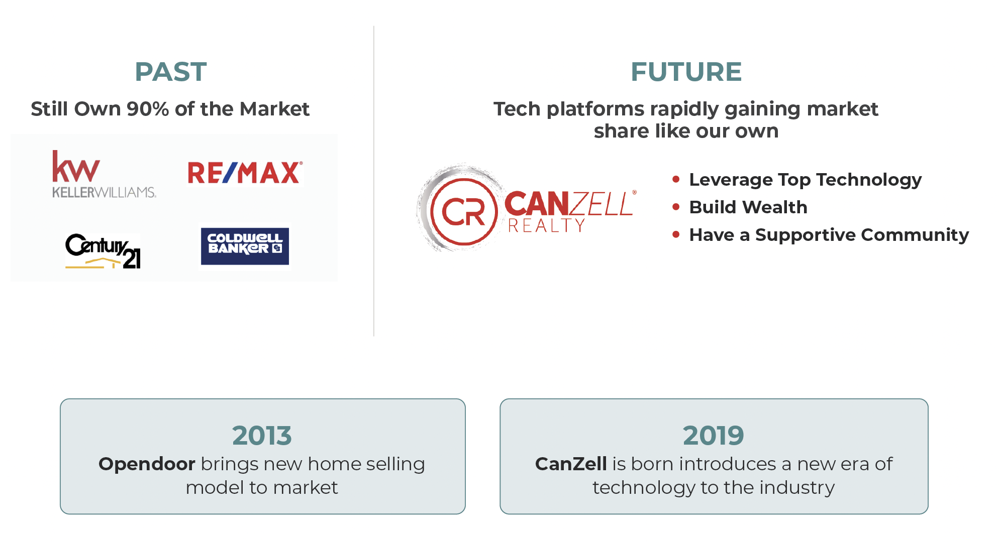
As of December 2022, there are 1.6 million agents in the U.S., 90% are with legacy brokerages that have had a dominant market share since the mid-1900s (1). We are beginning to see the market shift to a new model… (1)
(1)Data sourced from the National Association of Realtors.

Slide 8
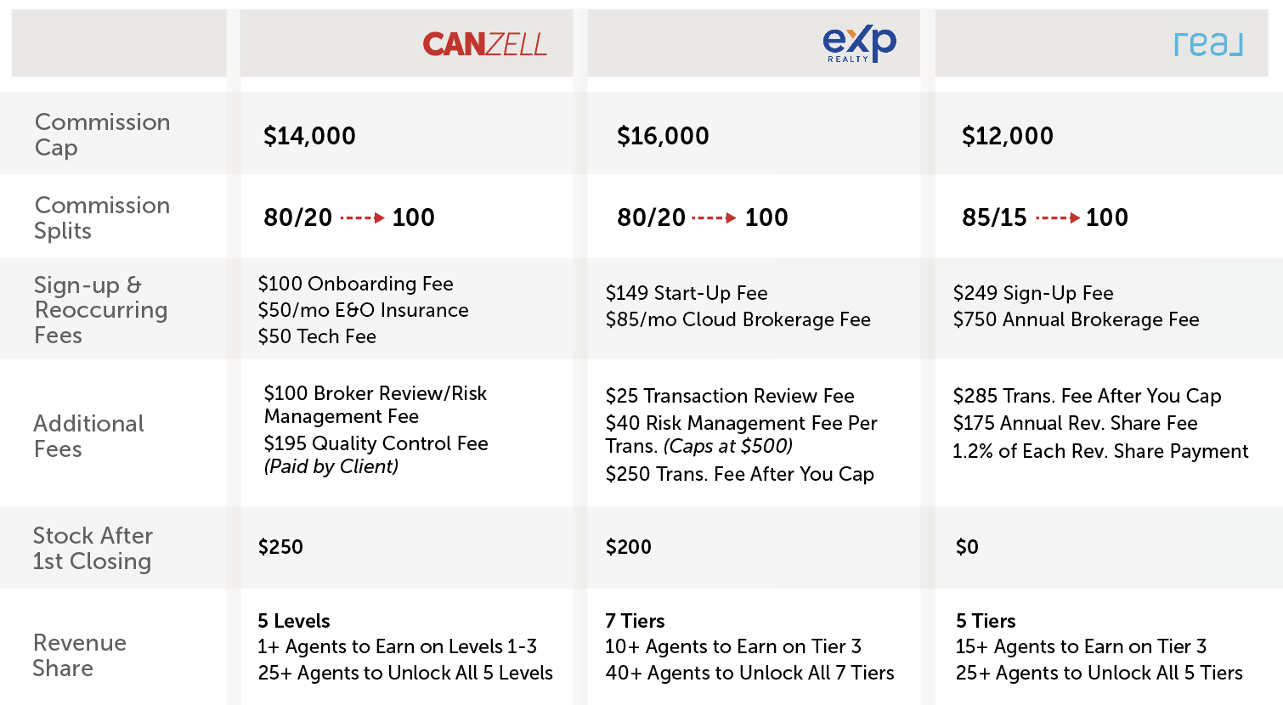
Comparison
of Cloud-Based
Brokerages

Slide 9
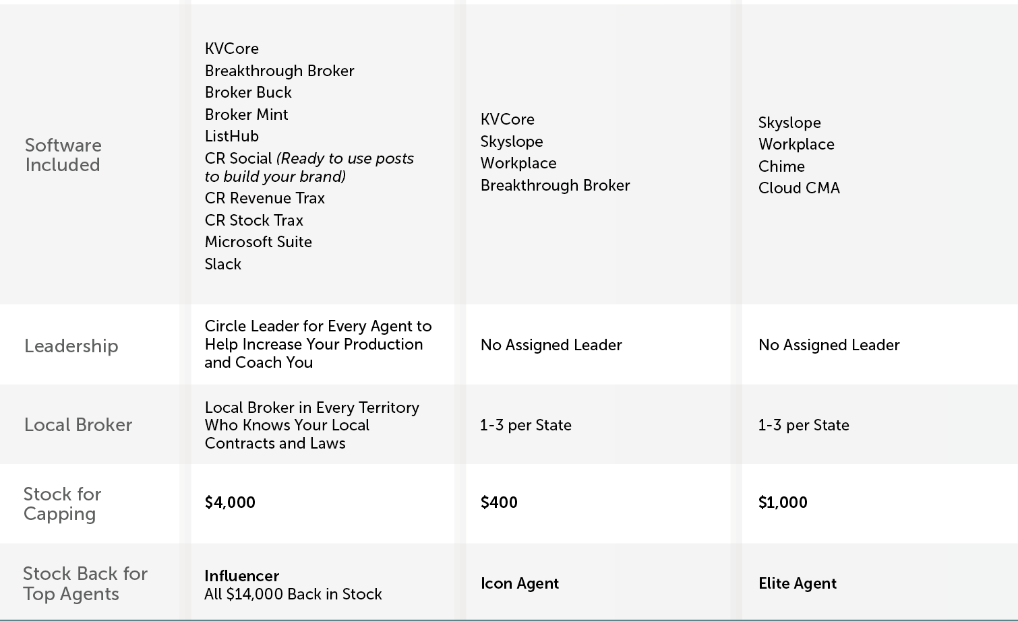
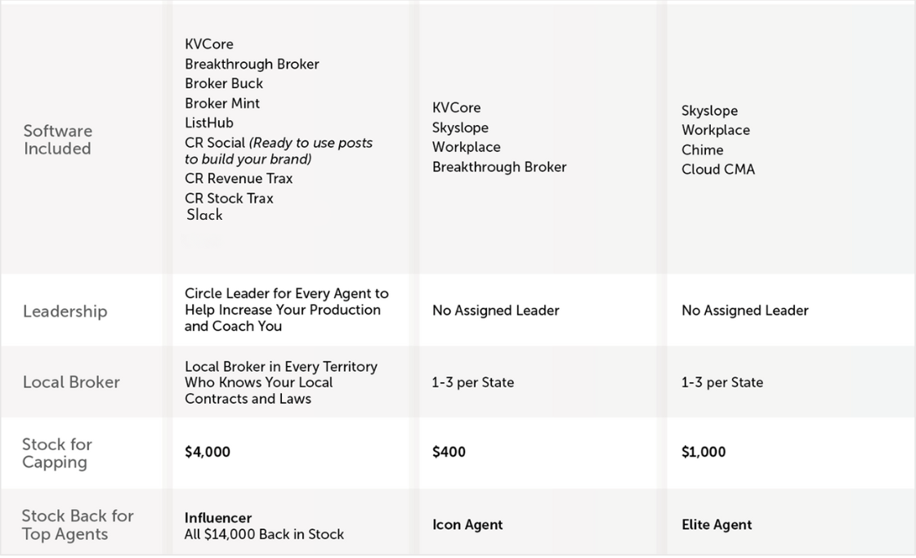
Comparison
of Cloud-Based
Brokerages

Slide 10
Real Estate
Brokerage Industry
It’s a $100B market at the beginning of a sea change
90% of consumers use agents to buy/sell homes, paying a commission when the transaction closes
1.2M agents in the U.S. are independent contractors required by law to hang their license with a broker
Traditional brokerages have high office overhead, low margins and lack automation, so they squeeze agents
A new breed of tech-powered brokerage is growing rapidly to serve agents better at a lower cost

Slide 11
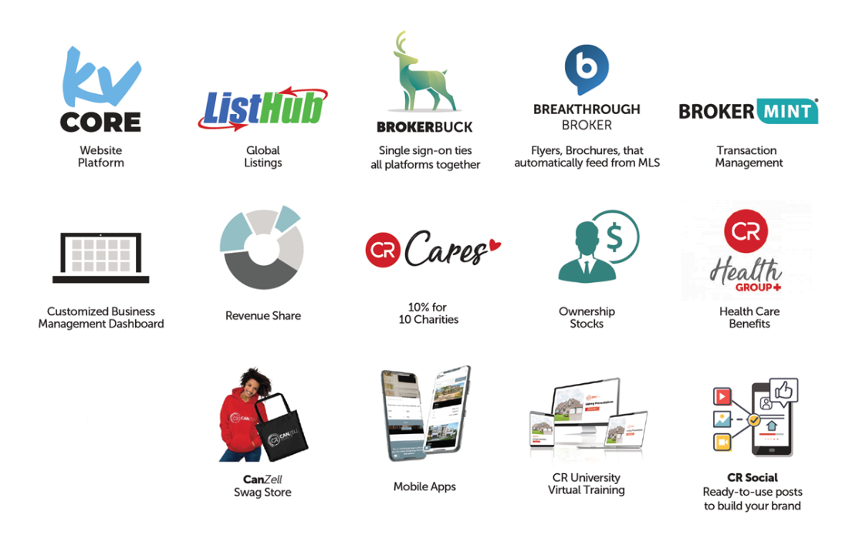
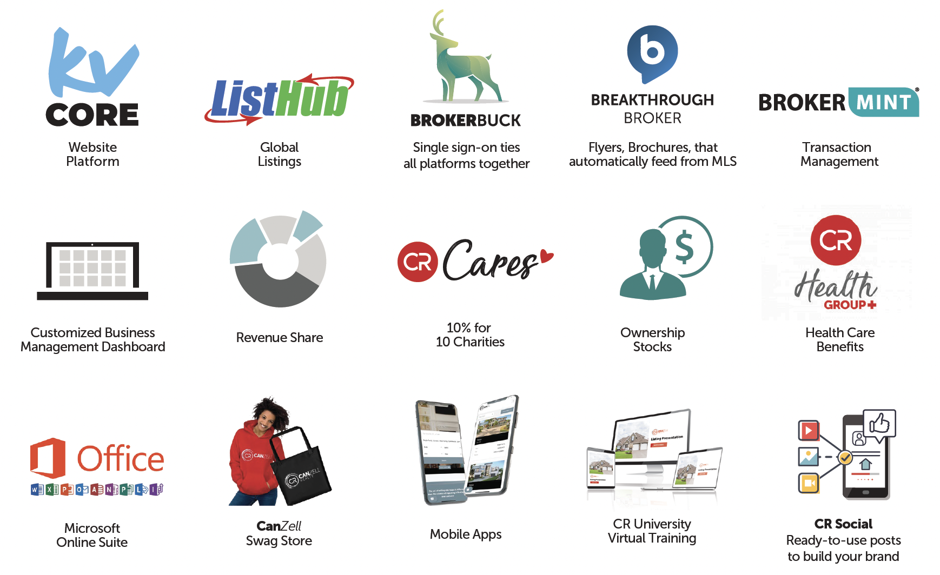
Everything you get with CanZell!
We have all the technology and tools you need to run your business!
There is no one system in real estate, so we’ve gone out and found the best technology for you.

Slide 12
Plus…

Slide 13
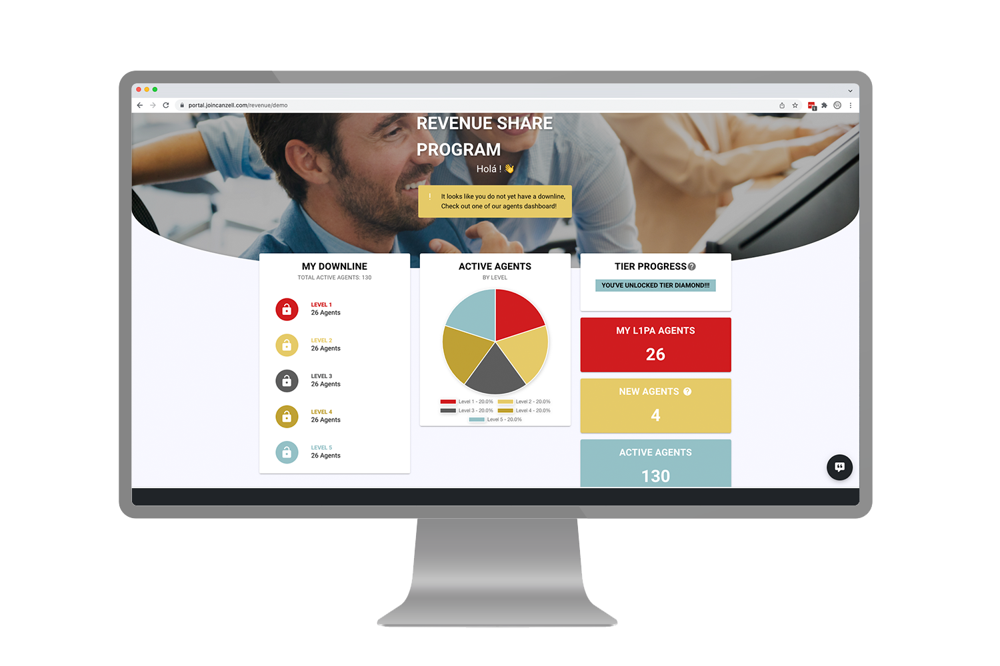
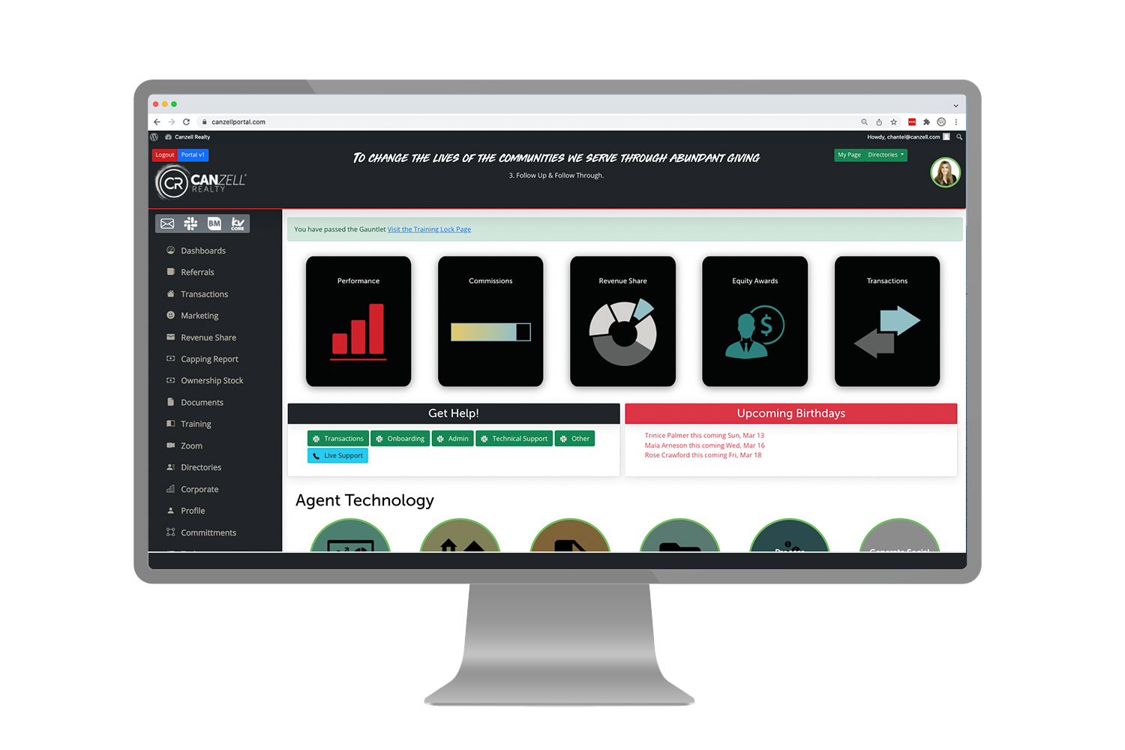

Proprietary Software
Personal Management
Transaction Management
Financial Management
Business Intelligence
Our Cloud-based mobile solution manages pipeline, transaction, and commission—a practically fully automated process, allowing for scalability. Our 3-person transaction team processes thousands of transactions, with the power of our technology.

Slide 14

Real-Time Support
One of the great things about CanZell Realty is the amount of leadership you have surrounding you. If you have a contract or broker question, you can go directly to your Broker. If you have a leadership or general question, you will go to your mentor, then your Circle Leader, then your Managing Partner and lastly your sponsor. They are all there to help answer all your questions to make sure you have a successful career at CanZell Realty.

Slide 15

Transaction Management
CanZell Realty provides dedicated transaction support specialists to ensure agents files are complete and accurate! With the use of Brokermint, agents can turn in documents for review and receive any feedback instantly. Once these documents are reviewed and accepted, the transaction coordination team will create the commission disbursement authorization form to ensure that the agents will receive their commissions soon after closing!

Slide 16

Agent Collaboration
In addition to CanZell Realty staff, brokers, and circle leaders, agents will find tons of support from other agents! Workplace and Slack are great tools that agents communicate with; agents have questions answered within minutes!
Are there In-Person Trainings?
Yes! Our Circles get together on a regular basis to do everything from training and mastermind events, to fun outings and team bonding!

Slide 17

Agents selling personal real estate only pay a $395 transaction management fee when buying or selling property in which they are on the title. They can do this up to 4 transactions each year in which they keep 100% of the ENTIRE commission.
Commission Splits +
Fees
personal real estate
Only $100 Broker Review and Risk Management Fee on each file.
No franchise fees.
80/20
$14k
commission split
annual cap

Slide 18
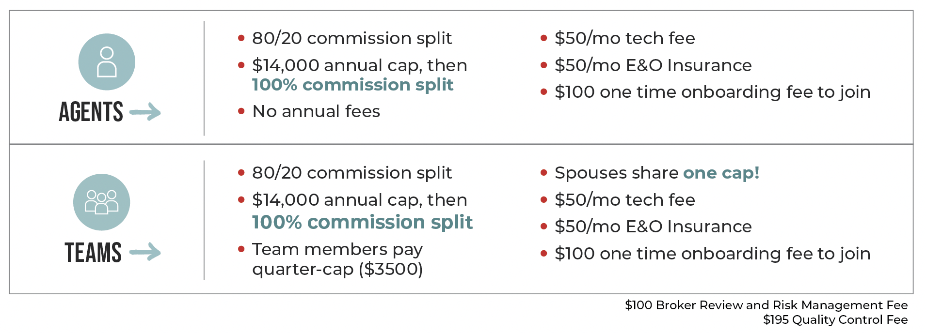
Commission Splits
Agents and Teams

Slide 19
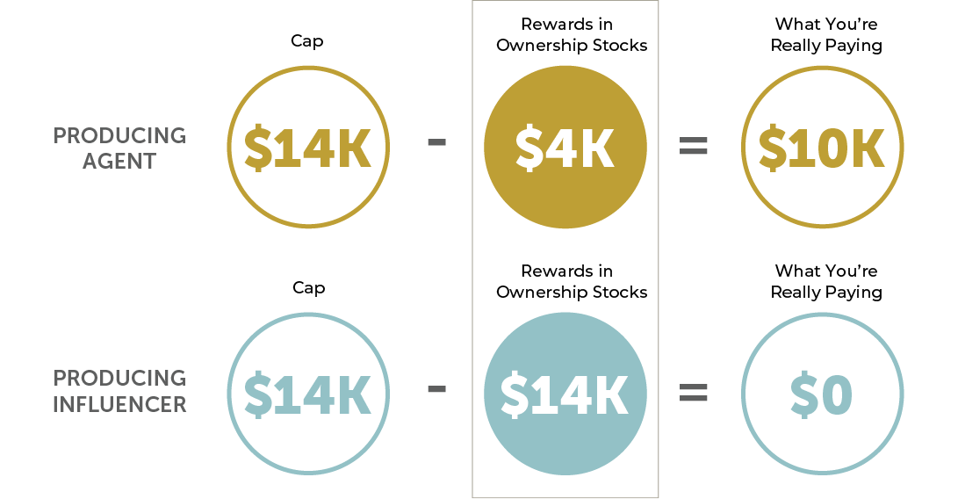
Ownership Stock
Earn Rewards
Pay as little as $0 in net commission

Slide 20
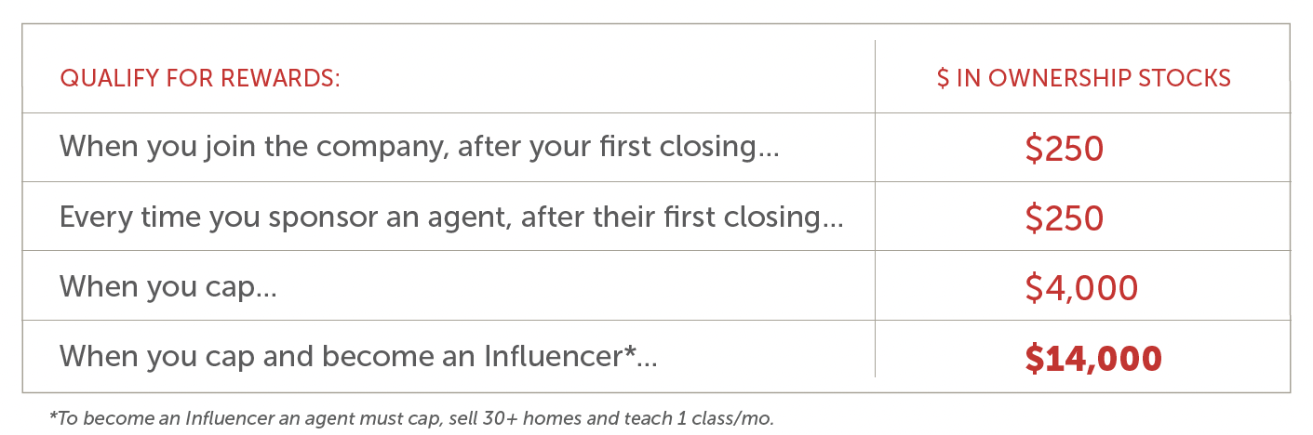
Ownership Stock
Earn Rewards

Slide 21
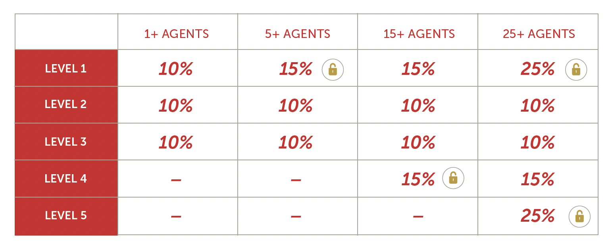
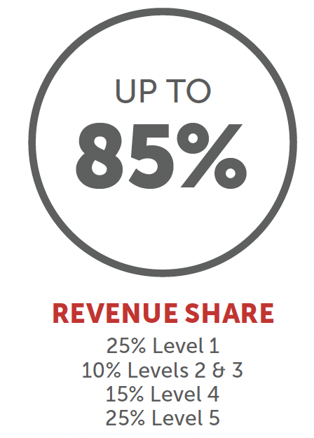
Revenue Share
At CanZell Realty, you have an opportunity to unlock up to 85% of company dollar in additional revenue just by attracting producing agents to the company.
5 Levels

Slide 22
Feedback from Real Agents
Here are 5 reasons why people made the switch and decided to JOIN CANZELL
from other Brokerages:
3 Levels are open immediately (vs. 5 agents required to open the 2nd level & 10 agents required to open the 3rd)
$14k cap (vs. $16k cap)
$4000 stock award for capping (vs. $400 at other company)
More Agent Support (vs. limited brokers that are spread too thin often 1 or 2 for the entire state & no company assigned guide/trainer)
Culture! it feels like family w/ lots of heart instead of a very corporate and cold environment

Slide 23

20 States
and counting!
Is CanZell Realty Sustainable?
CanZell Realty gives so much back to agents with Revenue Share, stock compensation, and lead generation tools, many agents wonder if the CanZell Realty business model can last into the future?
Our revenue share model pays out up to 85% of the company dollar back to agents, 11% to leadership and 10% to the charity of the client’s choice, allowing for the other 14% to go towards overhead, technology and profit. Because CanZell Realty has no physical brick and mortar offices, the overhead is substantially less than comparable brokerages.
Tech Focus

Slide 24
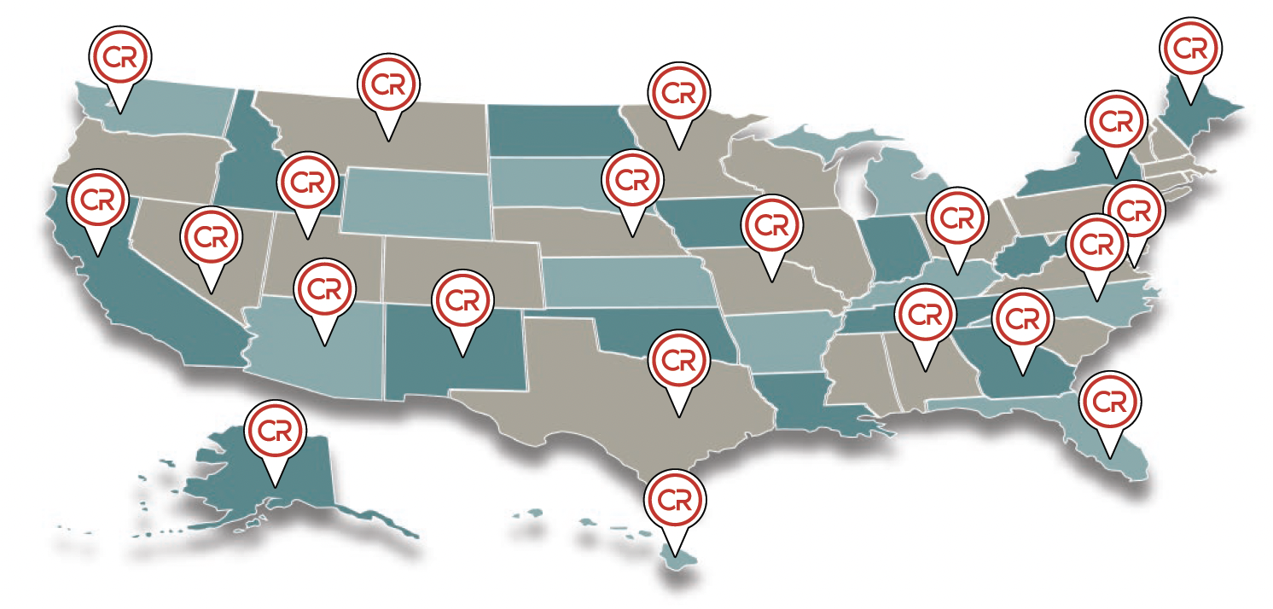
Growth Strategy
Agent referrals
CanZell agents earn revenue share through five tiers of referrals, creating a network growth effect.
Geographic expansion
CanZell is rapidly adding new states based on demand from productive agents. As territories grow, CanZell will invest to expand our Customer Referral Network allowing our agent to capitalize on highly-qualified leads and earn more money.
Retention
Equity plan, vested over years helps to retain agents. Providing top-notch technology and services, training and coaching promote agent retention.

Slide 25
Tech Focus
Operating system for agents
Automation of brokerage operations
Improve the experience for agents’ clients

Slide 26

Low Agent Acquisition Cost
$3000
$1140
–––––––
-$1860
On
First Sale
Cost

Slide 27

Recruitment
Goal to reach 2,000 agents
x2 = 2,000,000
Raise those items for the next 2 years.

Slide 28
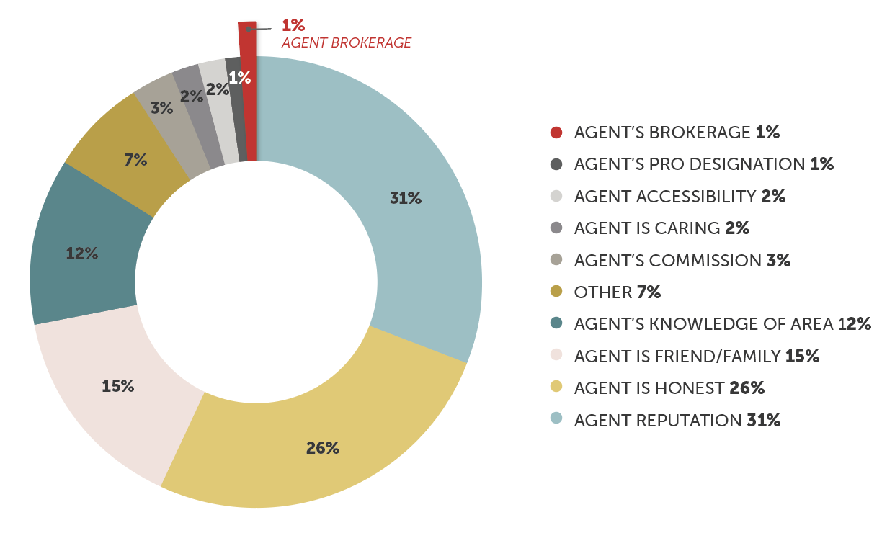
Why Clients Choose Their Agent
Agents Win Business, NOT Brands
Over 95% of clients choose an agent based on their abilities.
Only 1% of clients choose
an agent due to what brokerage they are with.
SOURCE: National Association of Realtors 2020 Profile of Home Buyers and Sellers, pg. 133

Slide 29
Hypothetical Revenue Model
 | Real Estate | Lead Gen | Mortgage | Title
Gross Revenue | $9,000 | $9,000 | $10,000 | $2,000
Gross Profit | $1,900 | $5,050 | $8,000 | $1,200
Gross Profit Margin | 21% | 56% | 80% | 60%
Operating Profit | $1,140 | $2,020 | $2,500 | $650
Operating Profit Margin | 60% | 40% | 25% | 32.5%

Slide 30
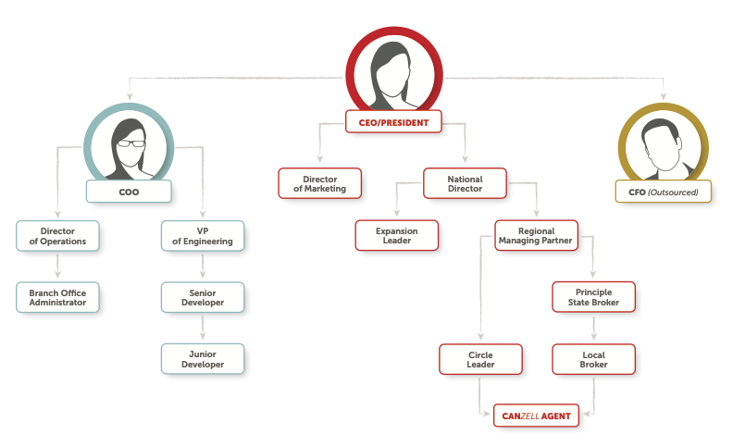
Organization Chart

Slide 31
NATIONAL SALES DIRECTOR
CIRCLE LEADER
BROKERS
How We Distribute
Money Within
the Organization
RECRUITER
SENIOR DEVELOPER
TEAM LEAD
FRACTIONAL CTO
$1 MILLION
MARKETING SPECIALIST
MARKETING

Slide 32
BOA:
boaall@canzell.com
Technical Help:
help@canzell.com
Transactions:
transactions@canzell.com
Billing, Commissions, and Accounting Help:
accounting@canzell.com
Revenue Share:
revshare@canzell.com
Contact Us:

Slide 33

LEARN MORE
JOINCANZELL.COM

