Slide 1
Welcome to the future of real estate

Slide 2
Stay powered by canzell
Leadership
Leads and Marketing
Concierge
Coaching
Giving

Slide 3
leadership
Circle Leader/Associate Broker
Your Circle Leader/Associate Broker will answer your immediate questions.
Have a direct line to someone that you know and trust
For those of you who want to grow in leadership: You can become a Circle Leader or Broker to agents in your market and CanZell pays YOU to grow those agents!

Slide 4
Leads
Receive training to become a CanZell Certified agent
Have access to our ZELL Guarantee to help attract and WOW your clients
Have access to CanZell Certified leads and exclusive Realtor.com leads for a 35% referral fee – no upfront costs!
Be part of a CanZell Certified Referral Network
Co-Marketing Partnership with Success Lending

Slide 5
Marketing
Get access to all of our Marketing materials to help increase production and with agent attractions
Get access to exclusive Marketing training on how to grow your business
Get 1 new video each month to help attract clients
Get an Exclusive Agent attraction site

Slide 6
Concierge
Get access to our admin to help with any training you need
Get access to our admin staff to help with any issues you have or they can connect you with the correct person at eXp
Get access to our admin staff to help with any set up and trouble shooting of CanZell portal products

Slide 7
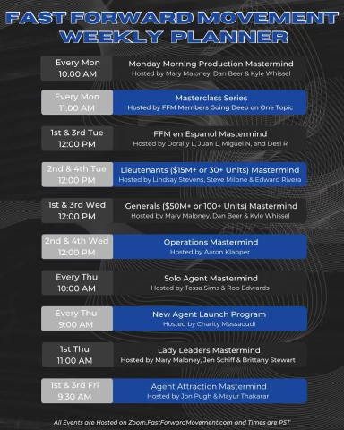
coaching
LIVE Training and Coaching classes held each day
Every Tuesday at 12pm EST, join our National Call with a Millionaire Real Estate agent from all over the country.
Have access to Jay Kinder's coaching calls and Honey Badger platform (would cost you $1000/mo)
One Big Fire Live Podcast: Every Tuesday at 11a CST LIVE in the Facebook group
Expert Mentors Live: Every Wednesday at 12p CST at http://Expertmentorslive.com
Honey Badger Bootcamp: Every Thursday at 11a CST at honeybadgerbootcamp.com
Funnel Fridays: Every Friday at 11a CST at honeybadgerleadgen.com
Have Access to Kyle Wissler's Live Daily Training Calls
Training calls for every area and agent is looking to grow their production
Have access to Chuck and Angela Fazio and their coaching
Learn how to grow your business and your revenue share
Have access to training with Dan Beer

Slide 8
Giving: 10 for 10
We are passionate about helping the communities we serve, so we will donate 10% of company dollar profit for each home sold by one of your clients.
There are 10 different charities to choose from. A few are: Immediate Need, Clean Water, Operation Christmas Child
When your client closes a home with CanZell, they will pick one of 10 charities when they fill out their closing survey
The donation comes from CanZell....not from the agent's side of the commission

Slide 9
CanZell Perks
$50/month tech fee CanZell Portal
Marketing Materials
CanZell kvCore site
1 video produced each month by the CanZell video team for your personal marketing
Personalized Join Site
CanZell Email sent to your personal email
HireUp portal to help with agent attraction
Digital Business Card

Slide 10
Brokered by exp
By joining as a CanZell Agent, you have access to special perks being offered by eXp!
Let’s take a look at what you will get...

Slide 11
Incentives
$149 joining fee paid by eXp...FREE for you!
No eXp fees for 6 months! ($85/mo after)
Public Stock – see your Circle Leader or Managing Broker to see how much upfront eXp stock you are getting!

Slide 12
Money...Money...Money
80/20 Split
$16,000 Cap – then you go to 100% commission
Can do both residential and commercial real estate under the same cap
Already capped? No problem...your capped status transfers over and follows your CanZell Anniversary date

Slide 13
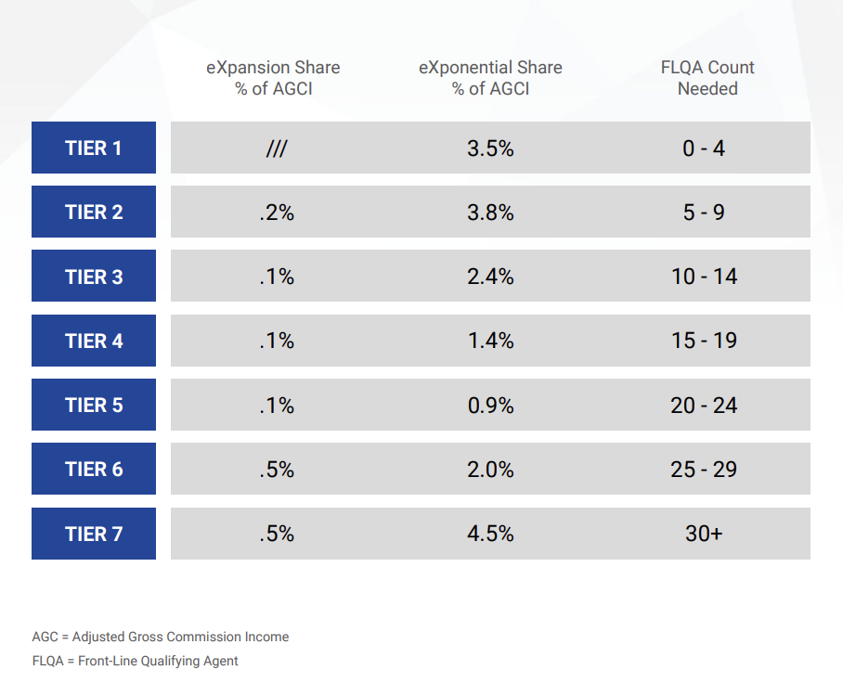
Revenue Share
First 3 levels UNLOCKED
7 levels of revenue share
Anyone you sponsored at CanZell, you will also be their sponsor at eXp

Slide 14
Stocks
Stock awards:
$200 of EXPI stock for first transaction closing
$400 of EXPI stock when agents cap
$400 of stock for directly attracting another agent after the agent closes their first transaction
Stock Option Program: Voluntarily enroll to receive 5% of net commissions from closed transactions at a 5% discount effective March 1, 2024.
ICON Agents: Top agents receive up to $16,000 in stock upon the achievement of certain production and cultural goals within their anniversary year

Slide 15
Technology & Benefits
kvCore
Workplace by Facebook
SkySlope
eXp Enterprise
eXp University
eXp Marketing Center
eXp World
Lofty – can purchase for an additional fee
Regus
Healthcare with Clearwater Benefits

Slide 16
You're Invited to expCon
When: October 27th – 30th
Where: Miami
Who: YOU (pssssst....we have some free tickets to give away)
Lodging:
Notilus Sonesta Miami Beach
Group Block: $226.22/night
To get this rate, contact Debra Myers:
352-279-8113
Debra.Myers@canzell.com
$

